Slide 1
Create Stability & Culture Playbook TEC-406-160015
Draft 2020
Global Operations

Slide 2




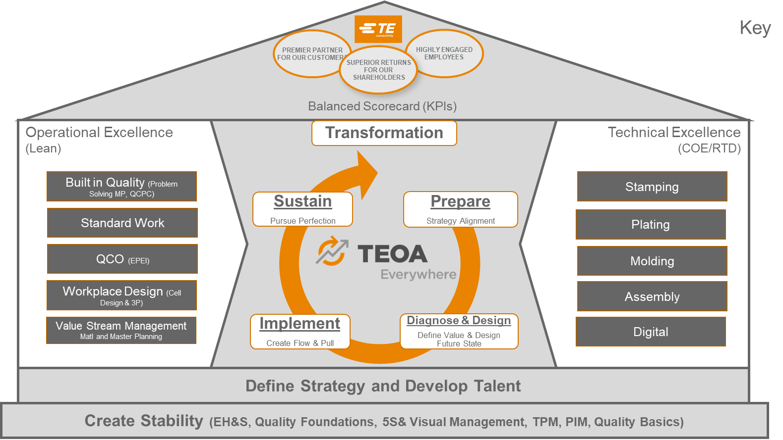
Using the Create Stability & Culture Playbook – What do the Icons Mean?
Where this Icon is visible refers to a point of information on the subject, linking to additional Playbooks or Training materials for example
Where this Icon is visible refers to a Tip / help
Where this Icon is visible refers to a special Note on the subject
Click on the agenda icon to return to the agenda for the current phase
Click on the Chart Icon to return to the main page
Return to Agenda

Slide 3


TEOA – Operations Management System
Key
PREMIER PARTNER FOR OUR CUSTOMERS
HIGHLY ENGAGED EMPLOYEES
Star Level Criteria
SUPERIOR RETURNS FOR OUR
SHAREHOLDERS
Transformational Tool
Balanced Scorecard (KPIs)
Operational Excellence (Lean)
Transformation
Technical Excellence
(COE)
Prepare
Diagnose & Design
Define Value & Design Future State
Implement
Create Flow & Pull
Sustain
Pursue Perfection
Strategy Alignment
Built in Quality ( Problem Solving MP, QCPC)
Opportunity to TE Best
Standard Work
Process Excellence Frameworks
Quick Changeover (EPEI)
Ready to Deploy Projects
Workplace Design (Cell Design & 3P)
Value Stream Management
(Material and Master Planning)
Technical Academies
Define Strategy and Develop Talent
Create Stability & Culture (EH&S, Quality Foundations, 5S& Visual Management, TPM, PIM)

Slide 4

Create Stability & Culture Overview
Playbook Objective
What is TEOA
TEOA Toolkit
TEOA Star System Infrastructure
Managing The Deployment
Fundamental Element Implementation
Building Capabilities
Available Resources
Conclusion
Note: Click on the links above to quickly access the topic

Slide 5
OBJECTIVE OF THE PLAYBOOK
The objective of this playbook is to provide a practical guide on how to manage building a TEOA foundation within your site.
It details the basic overall sequence of activities needed to drive operating performance, as well as key insights and considerations.
The playbook will outline several steps in a structured approach to getting started and implementing fundamental elements.
Note: This playbook is focused on transformation in manufacturing and logistics operations; although the transformation approach and methodology is similar, this playbook will not address transformation in the business processes. Please refer to the Business Processes Playbook (in development) for more detail.
Return to Agenda

Slide 6
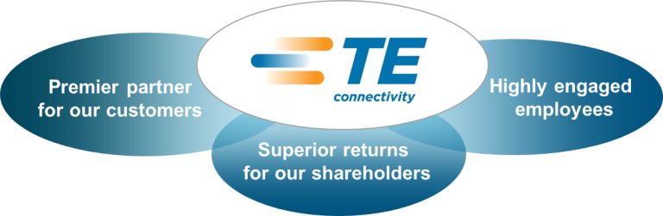

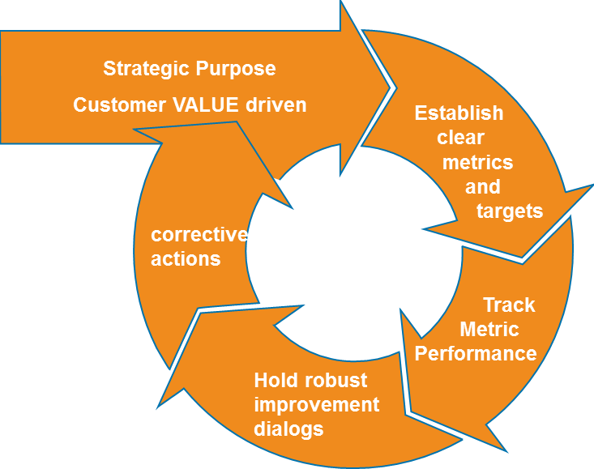
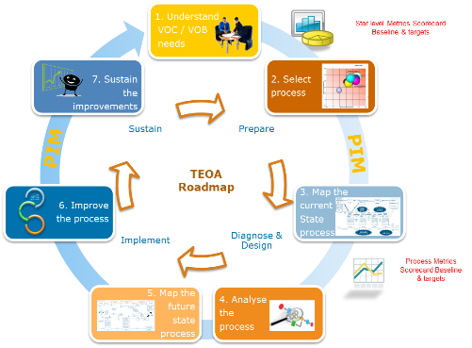


What Is TE OPERATING ADVANTAGE (TEOA)?
TEOA (TE Operating Advantage)
Is our Business System that drives every aspect of our culture and performance.
Is our Business Philosophy that aligns all activities in TE Connectivity to support the long-term strategic goals of our company.
Is based on relentless elimination of waste to continuously improve Safety, Quality, Delivery, Productivity and Lead time.
TEOA provides a range of proven tools, processes & resources that you can use to examine all aspects of your work and systematically drive improvement activities by engaging employees in doing the right things to achieve and sustain improvements.
Customer Focus is the driving force behind TEOA.
All employees in every function of the company are aligned to the goal of meeting our customer’s needs.
Strategy
We are Committed to Delivering an Extraordinary Customer Experience
PROCESS IMPROVEMENT
TEOA TOOLS
Management System
PEOPLE DEVELOPMENT
BUILDING CAPABILITIES
Leadership Behaviors
MINDSET AND CULTURE
Return to Agenda

Slide 7
What Is TE OPERATING ADVANTAGE (TEOA)?
The top of the house is the establishment of “what problem are we trying to solve”, or what is our purpose. This is the idea that drives the rest of the system. Some call this the “true north”.
Strategy
We are Committed to Delivering an Extraordinary Customer Experience
The process Improvement pillar represents the most tangible and visible elements of TEOA. This is the mechanics of TEOA, the tools, metrics, techniques, methods, etc. that are used to conduct process improvements. Process Improvement focuses on finding the best way to do things to achieve the flow and quality objectives of Lean.
PEOPLE DEVELOPMENT
BUILDING CAPABILITIES
PROCESS IMPROVEMENT
TEOA TOOLS
Management System
Capability development, especially people development, is important because people need to be trained with the skill sets and the knowledge to perform the tasks defined by the process improvements.
Leadership Behaviors
MINDSET AND CULTURE
The middle section - the management system - is the ‘heart of our TEOA continuous improvement system’ and needed to monitor and make sure that the process is continually running as intended, and if there are process interruptions, they are dealt with quickly to get the process back on track.
The management system supports the effective use of the tools and aligns roles and responsibilities to the purpose of creating value and achieving flow without waste. It is the leaders role to lead, manage and develop our people the ‘TEOA way
The mindset and culture are the way that people think and behave. Achieving a change in the culture away from an internal focus to a Lean, customer focus is often the most difficult challenge.
Return to Agenda

Slide 8
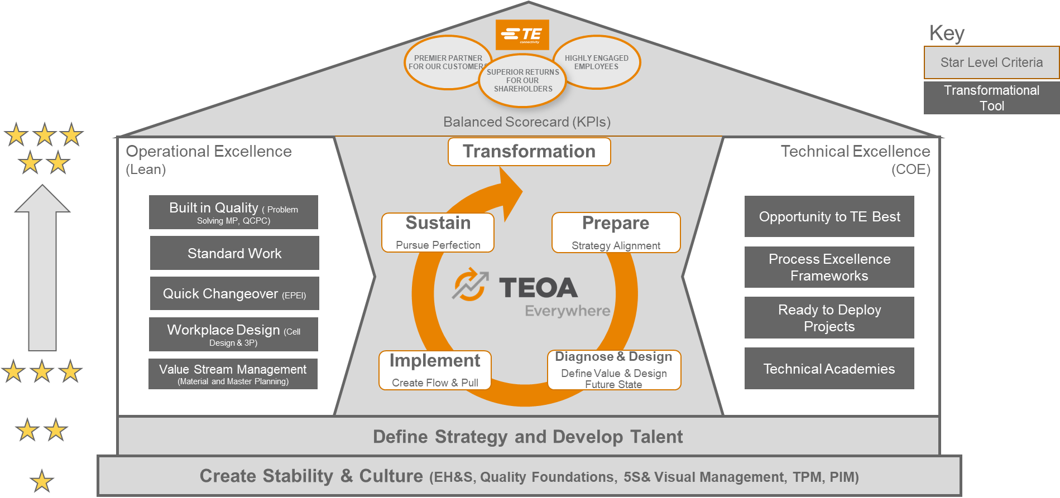
TEOA TOOLKIT DRIVING THE OPERATING SYSTEM
The TEOA Toolkit includes tools designed to drive step improvements in site operating performance. Five of the tools, designated as fundamental, form the core of TEOA and should be enacted at all sites and across all value streams.
Use of the remaining tools is based on applicability and/or potential impact. Detailed instructions for implementing TEOA principles will be covered through a variety of sources included in the TEOA Academy to which readers will be referred later in this playbook.
Return to Agenda

Slide 9
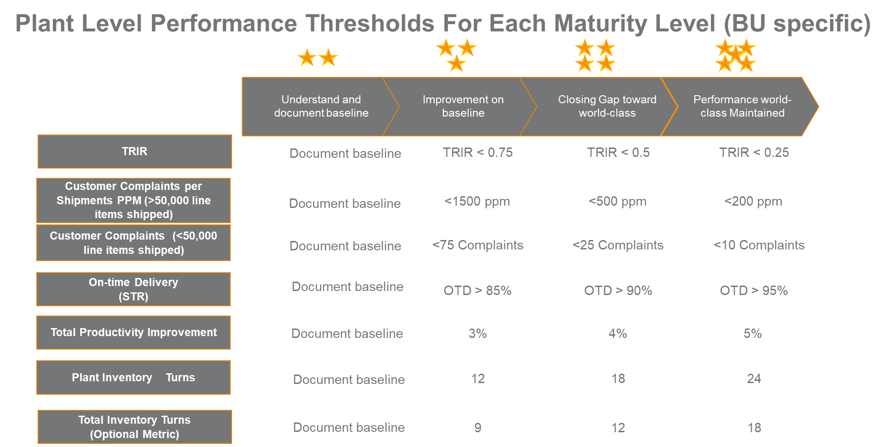

TEOA STAR SYSTEM INFRASTRUCTURE - Global Star Assessment Tool
TEOA uses a “Star” rating system to measure and track progress towards world-class performance at each of the global sites – which includes operations and all other business process functions.
Every defined site is required to complete a monthly or quarterly self assessment, which consists of two components:
Performance Scorecard assesses five critical performance metrics (Safety, Quality, Delivery, Productivity, Inventory) aligned to the business strategy; a Star rating is assigned to each metric based on the past month’s performance. Metrics are designed to record tangible improvements in results that are expected to follow Transformation.
Transformation Scorecard (5204) assesses the degree to which the site successfully implements the Fundamental and Transformational elements. The different star levels measure the depth and breadth of deployment. First deep, and then wide.
=
Together Performance and Transformation Implementation Scorecards determine a site’s overall Star rating.
Using the online assessment tool, sites report their star level progress for both transformation and metrics to operations management on a monthly basis.
Return to Agenda

Slide 10
Managing The Deployment
Add definition here
Return to Agenda

Slide 11

Managing The Deployment – Site Integration Team (SIT)
To support the transformation, a site level team should be established that will work together through each phase of transformation. The Site Integration Team is made up of the local site leadership and typically consists of 6-8 people. The purpose this team is to:
Set overall vision and direction for the deployment.
Lead the site communication process.
Remove roadblocks.
Provide resources for implementing the Fundamental Elements
Consider resources required for a value stream organization.
Review proposed ideas and make decisions.
Short-circuit traditional decision making.
Duration : Six weeks (suggested)
Return to Agenda

Slide 12
Program Management Activities
Program Management Activities:
Hold kick-off meeting
Training Activities
Reference available Playbooks & training and ensure key participants from the SIT team attend as necessary: TEOA ACADEMY
Preparation Activities
Establish baseline foundations at the site level.
Goals
Identify key site participants
Establish Site Integration Team structure
Develop Guiding Principles
Generate TEOA awareness within the site
Identify key site participants and establish SIT structure.
Establish Guiding Principles as a team to serve as the common objectives and true north for the site’s TEOA deployment.
Conduct awareness training and specific Fundamental tool trainings for all key site personnel.
Common Pitfalls:
Delayed identification of key participants inhibits the ability to have the local staff work towards common objectives.
Poor communication regarding the purpose of TEOA creates uncertainty regarding the site’s ultimate goals (for example: “Why exactly are we doing this?”).Consequently, site staff is not ready to support change, and will not be an active player in the transformation.
Return to Agenda

Slide 13
Managing The Deployment – Kick-Off Meeting
Once a site is designated for TEOA deployment, a kick-off meeting should be held with senior site leadership. Required attendees include the Site Manager, as well as senior direct reports (for example: production managers / supervisors).
The purpose of the meeting is to begin establishing a common understanding of TEOA, the transformation process, and the different phases.
Expectations for the site’s senior leadership include:
Accept responsibility to lead transformation program integration into the operating culture
Develop direct report goals and assign champions for specific deployment elements starting with the Fundamental.
Reinforce use of TEOA transformation tools and commitment to continuous problem solving and improvement
Establish strong, visible presence to drive change – both physical and cultural, assisting direct reports with site walkthroughs and observations
Quantify detailed goals to support the overall organization’s business goals
Output
Senior leadership team’s commitment to play an active role in the transformation initiative
Return to Agenda

Slide 14
Managing The Deployment – Key Site Participants
Work with the Site Manager to identify key site employees to take ownership of the deployment process.
These employees include local change agents and champions.
It is the responsibility of the change agent to steer the overall deployment process and to assist with implementation.
Change agents must possess the ability to drive implementation at the site level, including structuring problems for analysis and motivating and training operational (hourly and salaried) employees.
It is also critical to select individuals with substantial credibility in their home site.
Possible sources include supervisors and functional experts (for example: quality, procurement, materials planning, logistics and engineering).
Site champions must exhibit similar characteristics to change agents, and they own the implementation of approved initiatives. Ideally, champions exhibit a progressive, change focused track record in existing or previous roles.
All team members must be actively engaged and willing to support the site champions and change agents
Return to Agenda

Slide 15

Managing The Deployment – Develop Guiding Principles
Developing guiding principles is a critical first step prior to any lean transformation.
The key is not just to have guiding principles but to develop these guiding principles as a TEAM.
This is so important to get not only buy-in and involvement but also for continuity in the event that team members change.
The guiding principles should serve as “true north” and all improvement opportunities and future state designs should be in sync with the defined guiding principles.
For more information on guiding principles and some examples that have been used across TE please refer to the Guiding Principles module on the TEOA ACADEMY.
Return to Agenda

Slide 16
Fundamental Element Implementation
This chapter cover the topics associated with the fundamental elements of EH&S, Quality Foundations, 5s & Visual Management, TPM and PIM
Return to Agenda

Slide 17
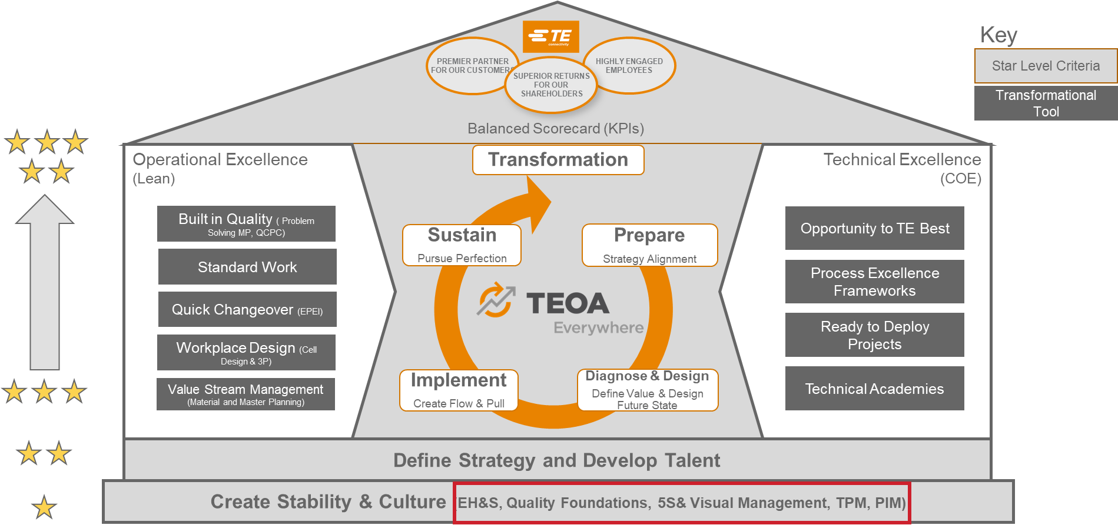
Fundamental Element Implementation
At the start of any lean journey, it is important to first establish some fundamentals. These fundamentals should be cantered on building stability within your site, creating the capabilities to improve in the future, and forming the discipline to sustain improvement.
In TEOA there are five fundamental elements and they are located at Star level 1 in the TEOA House;
Environmental Health & Safety (EH&S)
Quality Foundations (Fast Response & QMS)
5S & Visual Management
Total Productive Maintenance (TPM)
Process Improvement Management (PIM)
Return to Agenda

Slide 18
Fundamental Element Implementation
Environmental Health & Safety (EH&S)
EH&S The EH&S playbook describes how TE sites are expected to manage EH&S and the components of the EH&S program.
Quality Foundations
Quality Foundations is comprised of two sub tools, Fast Response & QMS.
5S & Visual Management
The purpose of a TPM program is to enhance equipment to ‘like-new’ condition. TPM also aims to engage workers in continuous improvement efforts to reduce machine down time and ensure maximum machine availability.
Total Productive Maintenance
Process Improvement Management
5S is a structured approach designed to cause workplace organization and process optimization by developing a culture of discipline and order.
PIM is the Management Operating System in a Lean environment and is the driver of a continuous improvement culture and enables the sustainment of process improvements over time.
Fast Response: A standardized process that focuses on the speed and effectiveness of our response to quality failures or concerns.
QMS: The basis for analysing customer requirements, defining the processes that contribute to the achievement of a product or service that is acceptable to the customer, and provisions for keeping these processes in control.
One of the first tools as implementation is relatively easy and serves as both a “quick win” and as an opportunity for shop floor supervisors and operators to “own” it.
The 5 S’s are: Sort, Set In Order, Shine, Standardize & Sustain
5S also stabilizes the process on a micro level and improves the overall safety of the workplace
TPM relies on autonomous maintenance as it requires engagement from all employees to take ownership, build the discipline required to sustain performance, and exhibit accountability for one’s work area and machines.
Through effective autonomous and preventative maintenance initiatives TPM results in fewer line stoppages increased productivity, extend equipment life and reduce life cycle costs, promote a safer working environment through cleaning or inspecting and improving equipment, while stimulating a culture of problem solving through more active involvement from all employees.
The elements of PIM are Leader Standard Work, Visual Controls, Tiered Accountability Process, and Discipline.
Benefits
Rapid improvements in Safety, Quality, Delivery and Cost
Implementation of immediate countermeasures or corrective actions.
Move from Reactive firefighting to proactive focus on processes.
Includes and recognizes the input of all employees.
Rapid identification of performance issues.
Problems are identified through visuals and solved at lowest tier possible.
Visual managements purpose is m is to focus attention on critical processes and activities and clearly communicate the status of relevant information of key areas in “real time.”
Robust, easily understandable visual controls which facilitates a control system for safety, product and information flow, operations standards, schedules and helps to highlight immediate problems to any observer.
Safety
There are three main elements to the EH&S Program:
It covers roles and responsibilities, data reporting, our EH&S programs, resource references, communication tools and training.
Environmental compliance
Sustainability
Click each header above to view the relevant playbook for more information on the subject
Return to Agenda

Slide 19
BUILDING CAPABILITIES – DEVELOPING YOUR PEOPLE
Lean deployments are difficult, and one of the most common reasons that they fail is because companies do not have the discipline to persevere or they fail to put enough emphasis on developing the necessary capabilities within their workforce to implement and sustain improvements.
TE recognized this from the beginnings of TEOA, and realized that the only way to truly get to world class performance, is to fundamentally change the mindset and culture within the organization.
TEOA is not just the responsibility of a select, few people. It requires complete buy-in at all levels of the organization. And to take it a step further, TEOA not only requires buy-in, but it also needs active participation from everyone involved in a lean deployment and transformation.
For more information regarding developing people refer to the Talent Development Playbook

Slide 20
BUILDING CAPABILITIES – Key Roles
All Employees
By engaging employees to identify opportunities for improvement, participate in Kaizen events, and empowering them to resolve problems when they occur, every employee can play a part in the deployment of TEOA & the transformation process in his or her part of the business.
TEOA Kaizen Facilitators
In both implementation roadmaps (Fundamental & Value Stream Transformation) there will be specific projects identified that will present breakthrough improvement opportunities. A mechanism for completing / implementing these actions and projects could come in the form of a Kaizen Event. A kaizen event is an uninterrupted focused improvement activity that typically takes place over 3-5 days.
TEOA Practitioners
Practitioners must be able to lead site wide and Value Stream initiatives and assist with the implementation.
Lean principles and TEOA can then begin to become a part of the mindset and culture at all layers of the organization.
Recommended Training: TEOA Overview Recommended Learnings: Basic Problem Solving Training, TEOA Tool Specific
SIT and value stream transformation teams need to be able to rely on select individuals who have the ability to facilitate and lead a group of participants through an event. A Kaizen Facilitator should be an effective coordinator, coach, communicator, critical thinker, and change agent.
Recommended Training: TEOA Overview, Lean training
They serve a critical role in identifying improvement opportunities to achieve the desired future state and must help develop the skills of the other local change agents / champions throughout the implementation.
The TEOA Practitioner should serve as the expert resource on the deployment and implementation of the TEOA principles.
Practitioners should exhibit a progressive, change-focused track record in existing or previous roles.
Recommended Training: TEOA Overview, Lean Foundations Basic Boot Camp, Quick Changeover Workshop, Lean Essentials Advanced Boot Camp, Creating Continuous Flow, Lead a Value Stream Transformation

Slide 21
AVAILABLE RESOURCES
There are a variety of resources available within TE to help with any aspect of the TEOA deployment & transformation process:
TEOA SharePoint: The TEOA SharePoint serves as the central repository for all things TEOA. Here you will find training calendars, training materials, best demonstrated practices, community blog, recommended reading material and plenty of other useful information and resources including TEOA personnel contact information.
TEOA Academy: The TEOA ACADEMY offers a collection of material for presentation in order to build technical knowledge and confidence. Training modules and handbooks detail each aspect of the global TEOA initiative in varying depths of knowledge and target specific audiences (for example: general operations personnel, shop floor supervisors and employees and senior site leadership).
TEOA Playbooks: Housed in the TEOA SharePoint is a repository for all available TEOA Operations playbooks for each of the different Star levels
LEARN@TE: Online Training system. Search for a topic to access information, training courses etc.
Note: Click on the links above to quickly access the topic

Slide 22
CONCLUSION
While this handbook is not a prescriptive step by step guide on how to implement fundamentals or transform value streams within your site, it does provide a proven formula for beginning a TEOA deployment.
The objective of this playbook aims to identify and answer two main questions:
Where should I start?
What resources and training materials are available to help me throughout my transformation?
Shifting from a prescriptive tool by tool implementation approach to a true, lean value stream transformation focus, will allow sites to better align with “true north”. That is, focusing on the lean principles to ultimately create flow and implement pull across an entire value stream in order to create / enhance customer value.
Lean transformations are doomed to fail without the proper support and buy-in from all layers of the organization; from the shop-floor to the senior management level, so it is critical to ensure all parties understand the guiding principles and objectives up front, prior to beginning your lean journey.
There are plenty of resources available to help guide you through your transformation, including the TEOA Academy, which has been created and enhanced over the years by lessons learned from deployments across TE since the inception of TEOA.
You are encouraged to get started! Learn by doing! And if you run into roadblocks, seek guidance, and of course, continue to improve!

